Slide 1

Lecture 5: Databases
WRPV301: Advanced Programming
Dr Simone Beets

Slide 2

What do we need?
Database
SQL Server
Access
Oracle
What are relational databases?
What are non-relational databases?
Bridge
JDBC
Application
Create tables in DB
Add data to DB
Delete from DB
Update data in DB
2
Notes:
Q: Who has worked with databases before?
Q: What types?
Say we have an application written in Java to manage student records.
The application will need to be able to store and manage data.
How do we do that?
1. We have the database shown here at the top (database layer)
Could be SQL Server, Access or Oracle or any other relational database.
2. Then we have the application at the bottom that a user will interact with, where we can…
3. And how do they communicate?
With Java Database Connectivity (JDBC), which is the bridge
You can write SQL queries in the Java program and get results back from the database.
We just need to make sure that we use the correct JDBC driver for our type of database
Q: What are relational databases?
Data in databases is stored in tables with rows & columns
Tables are linked using relationships (i.e., foreign keys)
Use SQL for queries
Data here is structured and follows a schema
Examples: MySQL, MS Access, SQL Server, Oracle, PostgreSQL
But then what are non-relational databases? (NoSQL)
They are more flexible & don’t use tables as the main data structure
Different types:
Document-based – like Mongodb (Data is stored in JSON documents)
Key-value stores – like Redis (data is stored as a pair (like a dictionary))
Column-based – e.g. Cassandra (data is stored by column, instead of by row)
Graph – data is stored as nodes & relationships
Used when:
Data is unstructured or semi-structured
Scalability & performance is important
Developing real-time applications, etc.

Slide 3
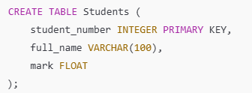
SQL statements & queries (examples)
CREATE TABLE tablename (fieldname1 VARCHAR (32), fieldname2 INTEGER, fieldname3 FLOAT);

Slide 4
SQL statements & queries (examples)
INSERT INTO tablename VALUES (value1, value2, value3);

Slide 5
SQL statements & queries (examples)
SELECT field1, field2 FROM tablename ORDER BY field2 DESC;

Slide 6
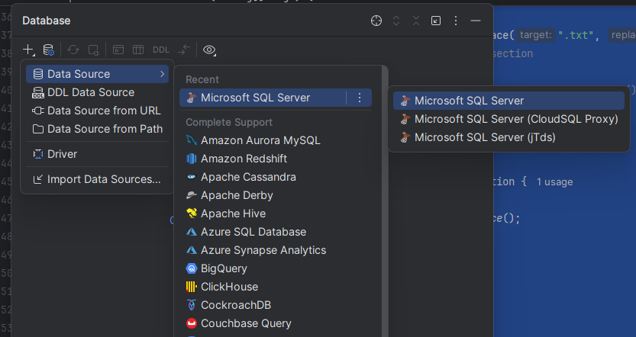
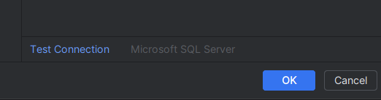
IntelliJ & databases
Database Window
Allows you to connect to, examine
& interact with an existing database
Allows you to obtain the settings
needed to connect with a database from code
To create a data source
Click the + button & choose type of database, e.g., SQL Server
Complete the details of the connection & click the Test Connection button
Notes:
Open the Database tool window, which will display on the right side of IntelliJ
Enable it from View > Tool Windows if not shown
Might need to download the driver (as mentioned in slide 1) if not yet used

Slide 7
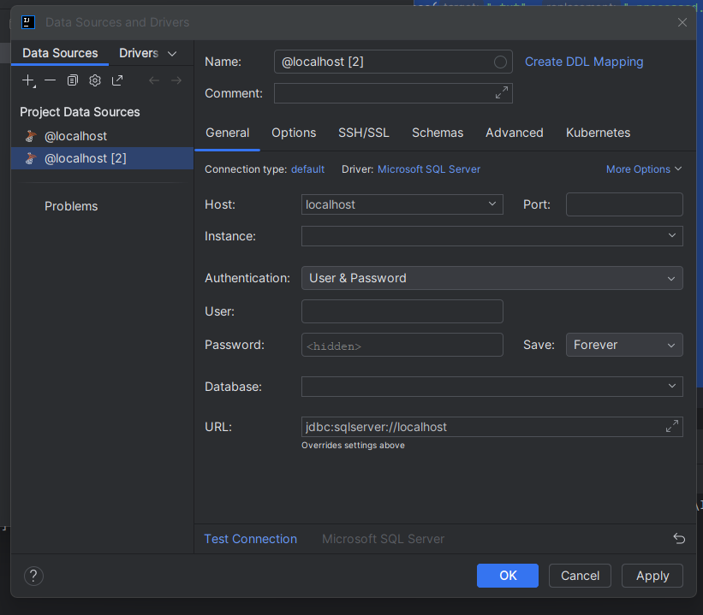
Delete the port
SQL User log in details
Database to use
Connection string (used in code)
Check that can connect

Slide 8
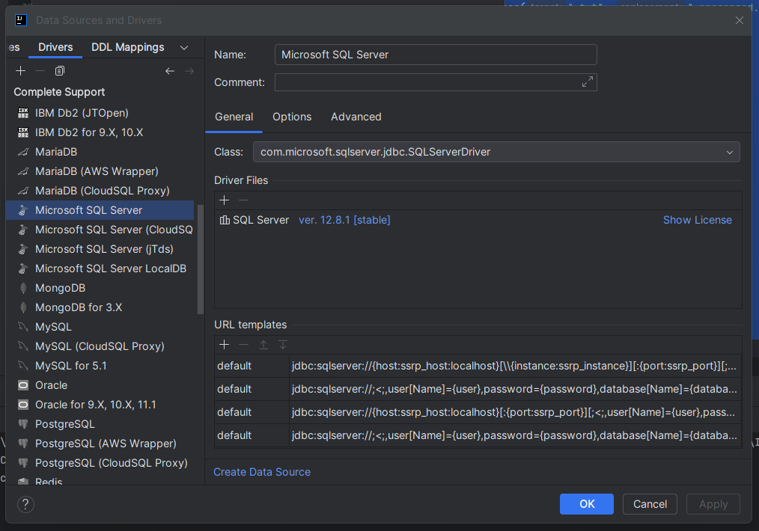
Name of Java class implementing the driver used to communicate with the database
Libraries to include in Module to gain access to drivers

Slide 9
Process
Link libraries to project
Load drivers to communicate with database
Establish connection with database
Obtain a statement(s) object to interact with db
Use statement(s) to manipulate db
Close database

Slide 10
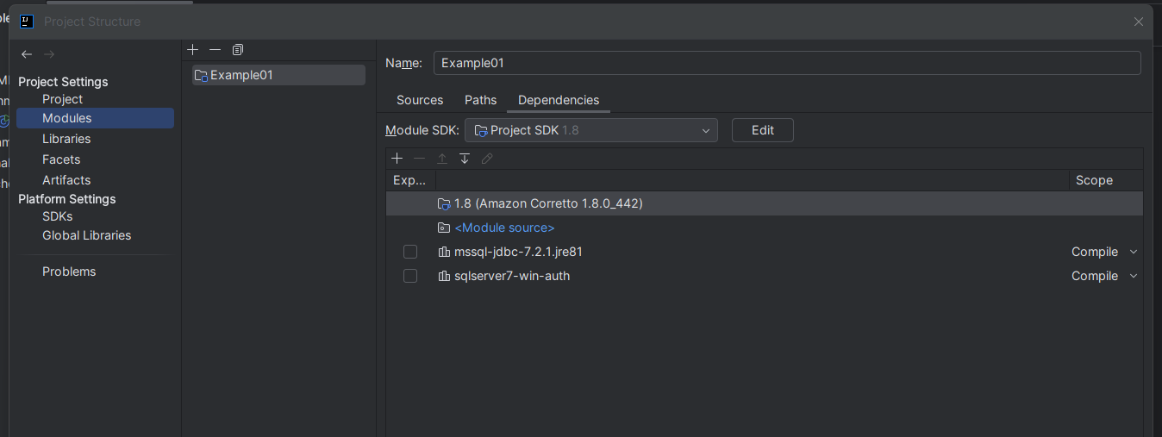
Link library & loading the drivers
Add library (specified in Database View) to your module/project
import java.sql.*;
Load the JDBC driver – string from Database viewer
Class.forName("com.microsoft.sqlserver.jdbc.SQLServerDriver");
Notes:
Still needed due to configuration here at NMU

Slide 11
Establish connection & obtain statement object
// setup connection string (copy from Database View line)
String connectionString = "jdbc:sqlserver://OPENBOX\\WRR;databaseName=WRAP301";
// create connection to DB Connection con = DriverManager.getConnection(connectionString, "WRAP301User", "1");
// create statement object for manipulating DB Statement stmt = con.createStatement(ResultSet.TYPE_SCROLL_SENSITIVE,
ResultSet.CONCUR_UPDATABLE);
Notes:
ResultSet.TYPE_SCROLL_SENSITIVE:
ResultSet will be scrollable (can move forward & backward through the results)
ResultSet will be sensitive to changes to the underlying data by other transactions while the ResultSet is open
So changes will be visible when navigating through the ResultSet
ResultSet.CONCUR_UPDATABLE:
ResultSet will be updatable (can read & modify using updateXXX(), e.g., updateString())

Slide 12
Using stmt & ResultSet
Execute SQL statements (no result)
stmt.execute(SQL statement);
Retrieve information through SQL queries (result returned)
ResultSet result = stmt.executeQuery(SQL Query);
ResultSet object contains rows of data that can be examined row-by-row using: result.next()
Data can be retrieved from the ResultSet:
result.getXXX(fieldname);
Data can be updated using the ResultSet:
result.updateXXX(fieldname, new-value);
result.updateRow();
Notes:
Stmt → java.sql.Statement
Execute basic static SQL queries against a database
ResultSet is the set of rows & columns returned by a SQL query
getXXX: XXX corresponds to the Java data type of the SQL column (e.g., getInt())

Slide 13
Metadata
Obtain metadata object:
ResultSetMetaData meta = result.getMetaData();
Obtain number of columns:
int columns = meta.getColumnCount();
Obtain column name (title):
String Cname = meta.getColumnLabel(j);
Obtain column type:
String Ctype = meta.getColumnTypeName(j);
Notes:
We can get information about the columns that you’re working with in a Java ResultSet object using ResultSetMetaData
“data about data”

Slide 14
How could metadata be useful to us?
Notes:
Q: Why useful?
Dynamic data handling: can write code to process results of SQL queries without knowing the structure of the ResultSet at compile time
E.g., generic data displays
For reports and displays: can dynamically generate column headers and format data based on types
For data validation & type checking
Database schema exploration – see the structure of tables in a query

Slide 15
Why metadata?
Dynamic data handling
For reports & displays
For data validation & type checking
Database schema exploration
Notes:
Q: Why useful?
Dynamic data handling: can write code to process results of SQL queries without knowing the structure of the ResultSet at compile time
E.g., generic data displays
For reports and displays: can dynamically generate column headers and format data based on types
For data validation & type checking
Database schema exploration – see the structure of tables in a query

Slide 16
What is a transaction in SQL?
One or more SQL operations that are treated as a single unit of work
All the operations in a transaction are either committed (completed successfully) or rolled back (operation failed)
Notes:
One or more SQL operations (queries, updates, deletions, insertions) that are treated as a single unit of work
All the operations in a transaction are either committed (completed successfully) or rolled back (operation failed)

Slide 17
Why do we use transactions in SQL?
Notes:
Ensures data integrity
Transferring money from one account to another → what if you take the money out the one account, but it fails to add it to the second account?
So these operations will happen together
Makes sure that the database state is consistent
Supports handling of concurrent access
What if you have multiple users and multiple environments? So data can be accessed/modified at the same time?
Can lead to concurrency issues like lost updates (overwritten changes), or dirty reads (if reading an uncommitted update, that doesn’t mean that that is the updated/correct information)
Facilitates error recovery
Can roll back entire transaction if one operation fails
Simplifies complex operations
Can group multiple database operations into a single logical unit
So you know the steps that need to happen at that stage to complete some functionality successfully

Slide 18
Why transactions?
Ensures data integrity
Supports handling of concurrent access
Facilitates error recovery
Simplifies complex operations
Notes:
Ensures data integrity
Transferring money from one account to another → what if you take the money out the one account, but it fails to add it to the second account?
So these operations will happen together
Makes sure that the database state is consistent
Supports handling of concurrent access
What if you have multiple users and multiple environments? So data can be accessed/modified at the same time?
Can lead to concurrency issues like lost updates (overwritten changes), or dirty reads (if reading an uncommitted update, that doesn’t mean that that is the updated/correct information)
Facilitates error recovery
Can roll back entire transaction if one operation fails
Simplifies complex operations
Can group multiple database operations into a single logical unit
So you know the steps that need to happen at that stage to complete some functionality successfully

Slide 19
Transactions in Java
Default:
all changes to the database are immediately committed
To stop auto-commit, call the connection object’s setAutoCommit(boolean); method
Call commit() to commit transaction
Call rollback() to drop all changes since last commit
Notes:
Java.sql.connection

Slide 20
Assignments
Assignment 2:
Due - check the schedule
Task 1: Submit using GitHub
(Will be graded using automated tests)
Rest of the tasks via Funda
Notes:
Module evaluations

